Slide 1
Long Term Care Insurance Reduced Benefit Options
Guidance Related to Reduce Benefit Options (RBO) Generally Associated with Long Term Care Insurance Rate Increases:
RBO Principles – Adopted Nov. 2020
https://content.naic.org/sites/default/files/inline-files/Two_RBO%20Principles_Adopted_TPR.pdf
RBO Communication Principles – Adopted Nov. 2020
https://content.naic.org/sites/default/files/inline-files/Three_RBO_Communication_Principles_Adopted_TPR.pdf
RBO Communication Checklists – Adopted Nov. 2021; Amended March 2023
https://content.naic.org/sites/default/files/inline-files/LTC%28EX%29TF_RBO_Communication_Checklist_3.13.23%20Adopted.docx
LTC Wellness Issues
https://content.naic.org/sites/default/files/inline-files/LTC%20wellness%20program%20issues%20-%20120721%20RBO%20SG%20-%20adopted_0.docx

Slide 2
Long Term Care Insurance Reduced Benefit Options
Communications Checklist Amendments
Clarity
Better examples and clearer specifications about what to look for (16, 19, 20, 22, 31, 35, 37, 38, 44, 49)
Corrections
Fixed typo (16)
Formatting (headers)
Robustness
Added customer experience consideration (31)
Added Third Party Notifier question (58)
Sentence structure or grammar (39, 50, 54)
With additional clarity, removed duplicate question (*49)
Clarified confusing question (23)
Added storing paper notice in safe place (57)
*Refers to Nov. 2021 version

Slide 3
Long-term Care Insurance Reduced Benefit Option Choice Selection Experiment
Brenda Rourke, PhD
Jeff Czajkowski, PhD
Center for Insurance Policy and Research (CIPR)
Senior Issues (B) Task Force
December 1, 2023

Slide 4
Department of Insurance Survey (May-June 2023)
3 Broad response categories
RBO Principles
5 principles: To evaluate RBO offerings
RBO Communication Principles and Checklist
6 Principles: To Ensure Quality Consumer Notices of Rate Increases and Reduced Benefit Options.
Future directions for LTCI consumer research
36 states responded

Slide 5
Key take-away from surveys
54% of respondents are using some (if not all) of the RBO Principles.
36% have incorporated some of the Communication Principles into their review process.
14 states indicated that the guidance and/or checklist
Aided in completing the review
Helped identify and correct issues with the insurer’s communication.

Slide 6
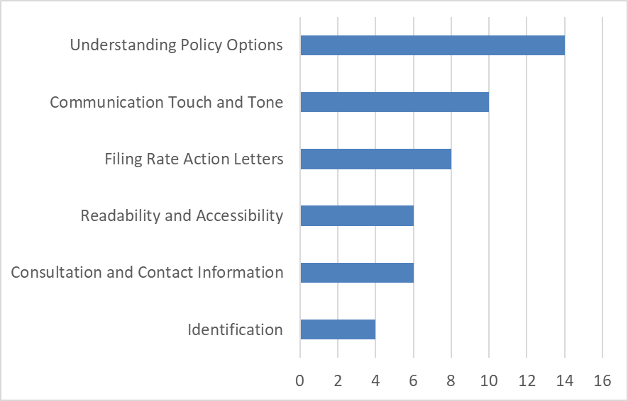
In what way, or which aspects of the guidance/checklist, were most helpful?
6

Slide 7
Communication Checklist
Communication Touch and Tone
Understanding Policy Options
Does the communication remind consumers to reflect on the original reason they bought the policy?
Does the communication express an understanding of the difficulty of evaluating choices?
Is there a statement telling consumers how to contact the insurer for more information or help understanding their options?
Are the options represented fairly? Options are not presented fairly If one option is emphasized, mentioned multiple times or bolded when the other options are not.
Are words used that could influence a policyholder’s decision, such as must or avoid? For instance, consider demonstrating immediacy by using the word “now and avoiding words like “must.” Consider “manage an increase” instead of “avoid an increase.”
Value of Options | 78%
Impact of Decisions | 78%
Current Benefits | 64%
Personal Decisions | 57%
Window of Time to Act | 50%
Presentation | 43%
Past Rate Actions | 29%

Slide 8
Since the Task Force’s adoption of the checklist in early 2022, they have seen an improvement in the quality of consumer notices submitted by insurers.

Slide 9
Consumer Research Focus

Slide 10
Proposed Research

Slide 11
RBO Choice Outcomes
 | Company | Premium Increase | Benefit Decrease | Annual Premium | Maximum Lifetime Benefit | Value Indicator | Check ONE Box
CURRENT COVERAGE |  | - - - - | - - - - | $3,782 | $367,000 | 22.40
OPTION 1 (DEFAULT) |  | +0.0% | -15.5% | $3,782 | $320,000 | 18.93 | 1
OPTION 2A |  | +0.0% | -32.8% | $3,782 | $252,000 | 15.04 | 2A
OPTION 2B |  | +25.0% | -23.7% | $4,728 | $287,000 | 13.68 | 2B
OPTION 2C |  | +50.0% | -12.3% | $5,673 | $321,000 | 12.77 | 2C
OPTION 2D |  | +75.0% | -5.3% | $6,619 | $356,000 | 12.12 | 2D
OPTION 2E |  | +89.5% | -0.0% | $7,166 | $376,000 | 11.82 | 2E
What can we understand about what drives LTCI
policyholders to make this RBO choice?

Slide 12
 | Company | Premium Increase | Benefit Decrease | Annual Premium | Maximum Lifetime Benefit | Value Indicator | Check ONE Box
CURRENT COVERAGE |  | - - - - | - - - - | $3,782 | $367,000 | 22.40
OPTION 1 (DEFAULT) |  | +0.0% | -15.5% | $3,782 | $320,000 | 18.93 | 1
OPTION 2A |  | +0.0% | -32.8% | $3,782 | $252,000 | 15.04 | 2A
OPTION 2B |  | +25.0% | -23.7% | $4,728 | $287,000 | 13.68 | 2B
OPTION 2C |  | +50.0% | -12.3% | $5,673 | $321,000 | 12.77 | 2C
OPTION 2D |  | +75.0% | -5.3% | $6,619 | $356,000 | 12.12 | 2D
OPTION 2E |  | +89.5% | -0.0% | $7,166 | $376,000 | 11.82 | 2E
Further, what can we understand about how identified LTCI RBO
communication best practices influence RBO choice?

Slide 13
Design and Implement Research Experiment to Assess Both
Receive RBO letter that follows Communication Principles (treatment)
Place Survey Respondents into LTCI hypothetical context
(e.g., cost of care; health condition; previous rate increases)
Account for other choice factors (e.g., financial literacy)
Elicit RBO Choice Intention
Assess influence of treatment
Receive RBO letter that does not follow Communication Principles (control)
Identify subset of respondents that have gone through RBO choice – qualitative assessment
Statistically model RBO choice intention to identify
drivers of choice and influence of treatment

Slide 14
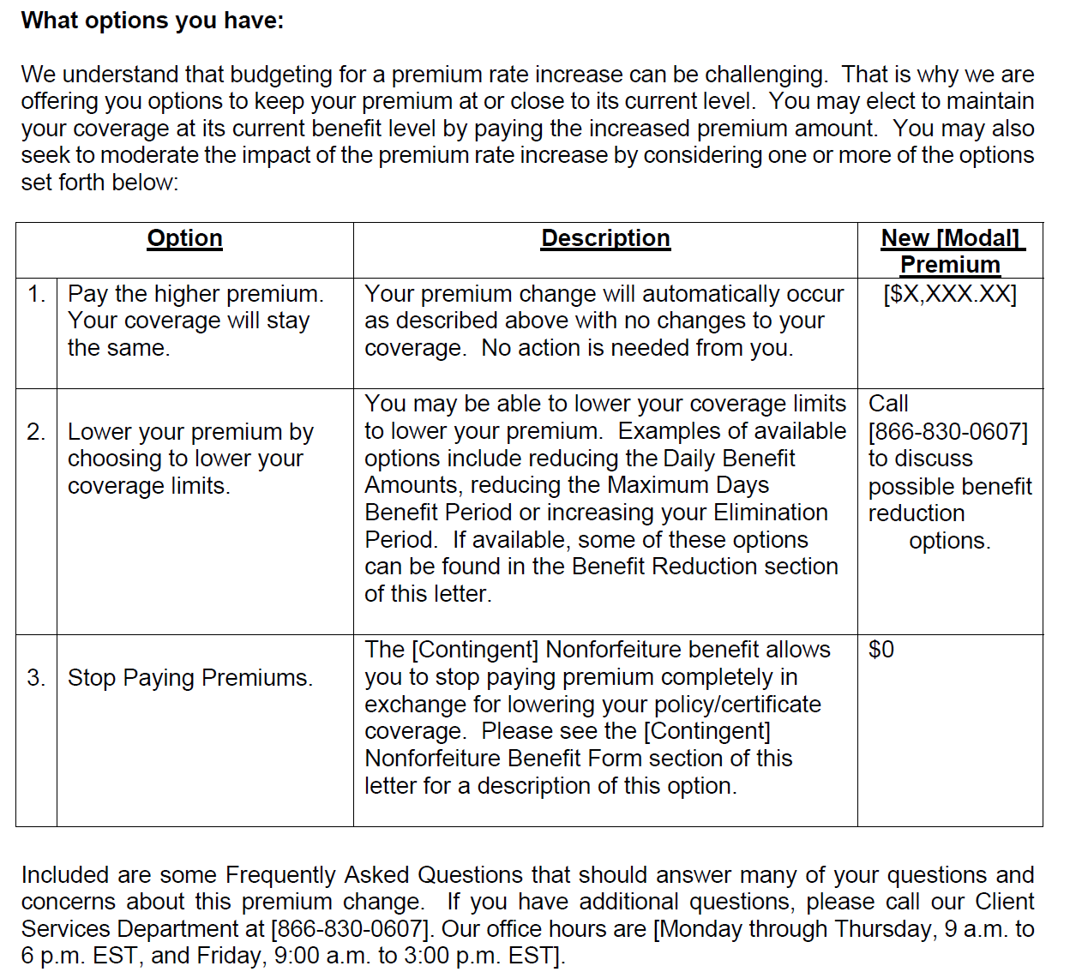
Please select one of the following options:
Option 1: Pay the higher premium. Your coverage will stay the same.
Option 2: Lower your premium by choosing to lower your coverage limits.
Option 3: Stop Paying Premiums.
Notes:
This is a sample letter that we received. This state indicted that this letter is an example of one in which they felt the letter met the guidelines for readability and accessibility, touch and tone, and helps the consumer understand their options.
We can remove the parts of the letter that express an understanding of the difficulty of evaluating choices.
We can remove tables that help to understand the options.
And remove FAQ's that aid clarity.

